Slide 1

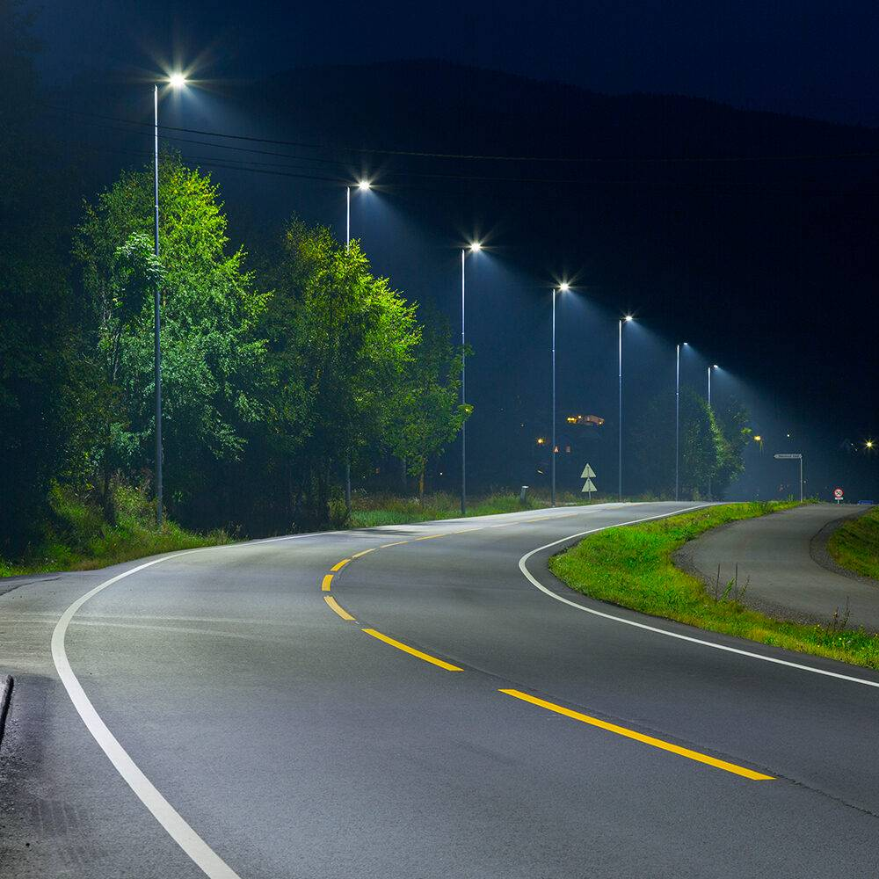

INTELLIGENT STREET LIGHTING SYSTEM
GROUP NO: 14
210334N - LAKSHAN S.H.K. 210337C - LAKSHITHA G.N.K.
210338F - LANKANAYAKE L.M.I.A.

Slide 2

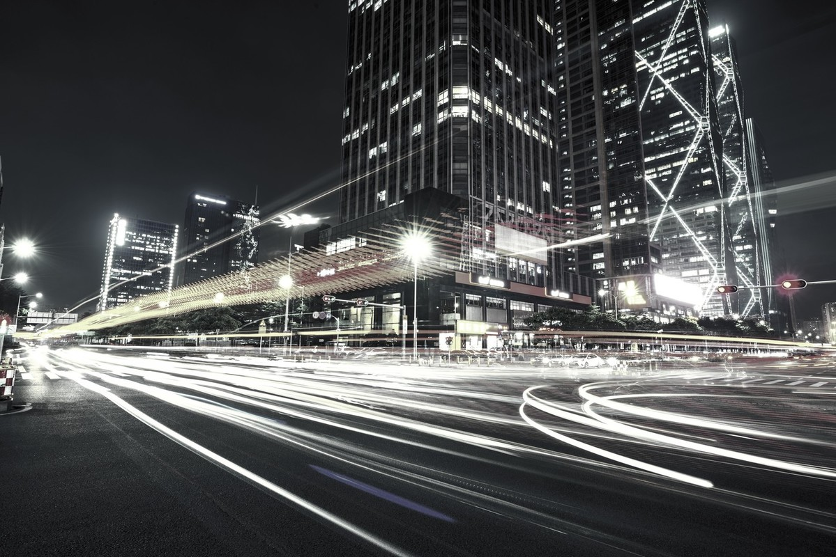
Introduction
Our project focuses on the development of an intelligent street light system designed to enhance energy efficiency and urban safety. This system incorporates three sensors and two actuators to dynamically adjust the street lighting based on environmental conditions.

Slide 3
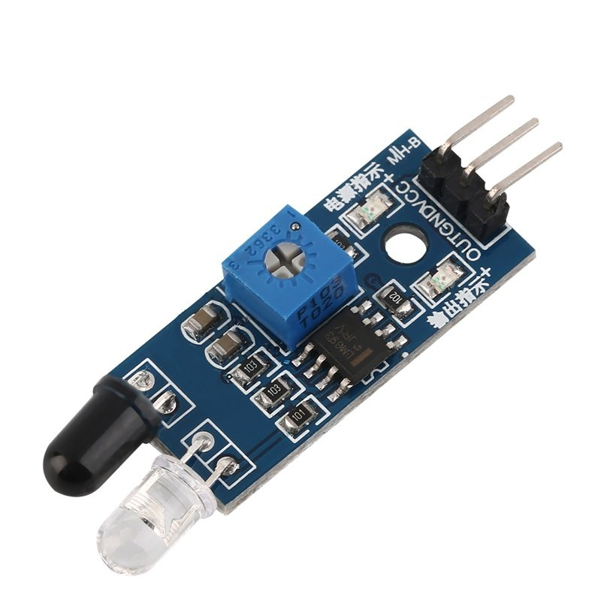


IR Sensor
In this application, we use an IR sensor to detect objects passing by certain place.When an object is detected at night, the sensor signals the street light to turn on, providing illumination only when needed.

Slide 4
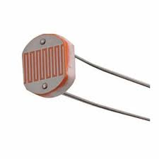
LDR Sensor
We use an LDR (Light Dependent Resistor) sensor to detect whether it is day or night. When the sensor indicates low light levels (nighttime), it triggers the system to prepare the street lights for activation.

Slide 5
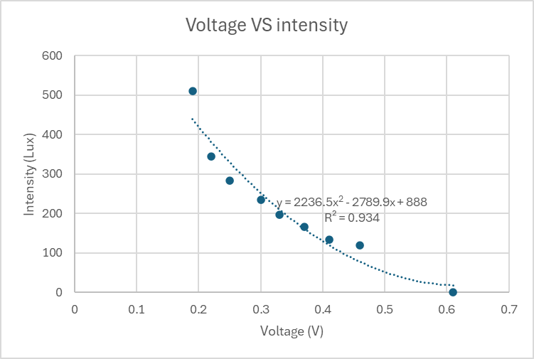
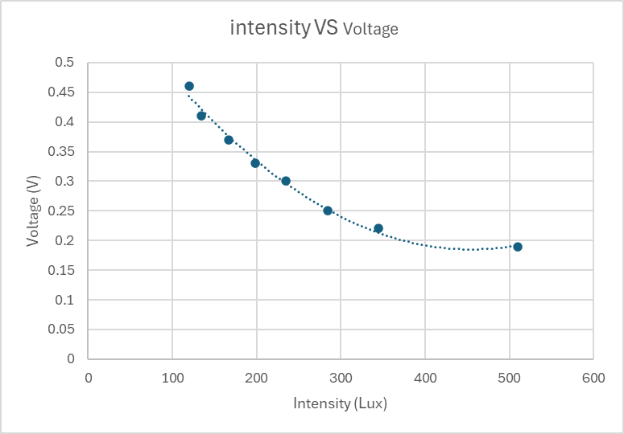
Calibration

Slide 6
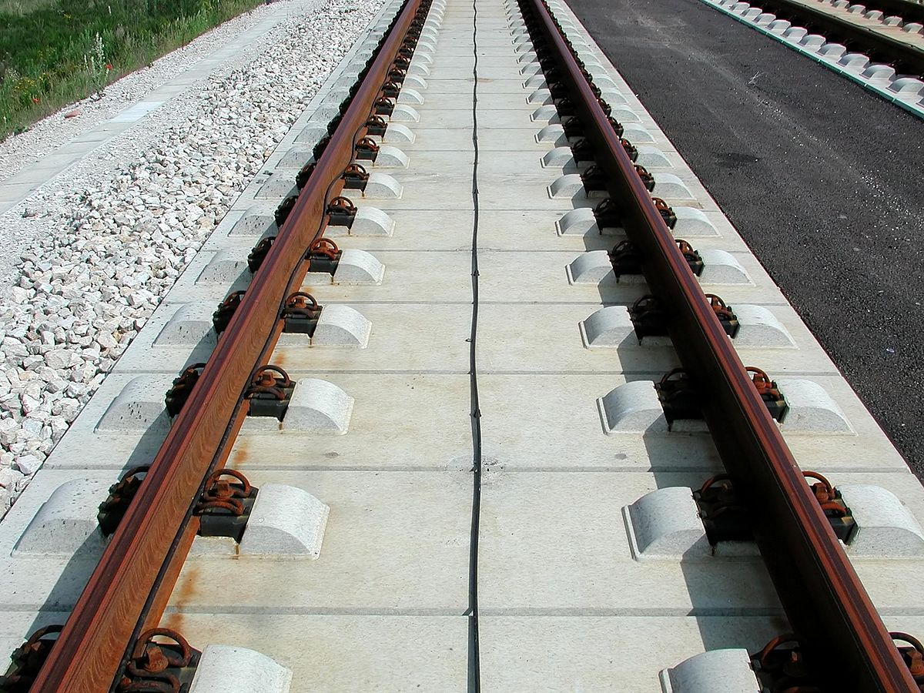

Train Detection Sensor
We designed a custom Train detection sensor using a piezoelectric sensor and a conventional tracking circuit . When a train approaches, the sensor detects the vibrations, triggers a signal, and activates servo motors to respond accordingly.

Slide 7
Thank You

